Slide 1

Hotel Booking Data Analysis & Insights Dashboard
Exploratory Data Analysis, Data Cleaning & Visualisation using Power BI || Excel
Darshan Chavhan | Power BI Analytics Project

Slide 2
Table Of Contents
Problem Statement
Data Overview
Data Cleaning & Preprocessing Excellence
Advanced Data Engineering & DAX Measures
Key Visualisations Driving Insights
Data-Driven Recommendation & Future Vision
Conclusion

Slide 3

Problem Statement
The hotel sector generates vast amounts of booking data daily, yet key insights often remain hidden.
Management faces difficulties in tracking booking trends, understanding the causes of cancellations, and identifying profitable customer segments. This lack of actionable insights leads to missed revenue opportunities and inefficient operations.
Hence, analyzing Hotel Data uncovers meaningful patterns and supports evidence-based business decisions.

Slide 4

Dataset Overview: The Foundation
Data Volume
Data Source
~119,390 rows of booking records
CSV format hotel booking dataset
32 columns capturing guest and booking attributes
Comprehensive historical records across multiple properties
Key Attributes
Hotel type, booking status, stay duration, ADR, guest demographics, country of origin, market segment
The dataset provides a rich foundation for understanding booking patterns, guest preferences, and revenue dynamics across resort and city hotel properties.

Slide 5
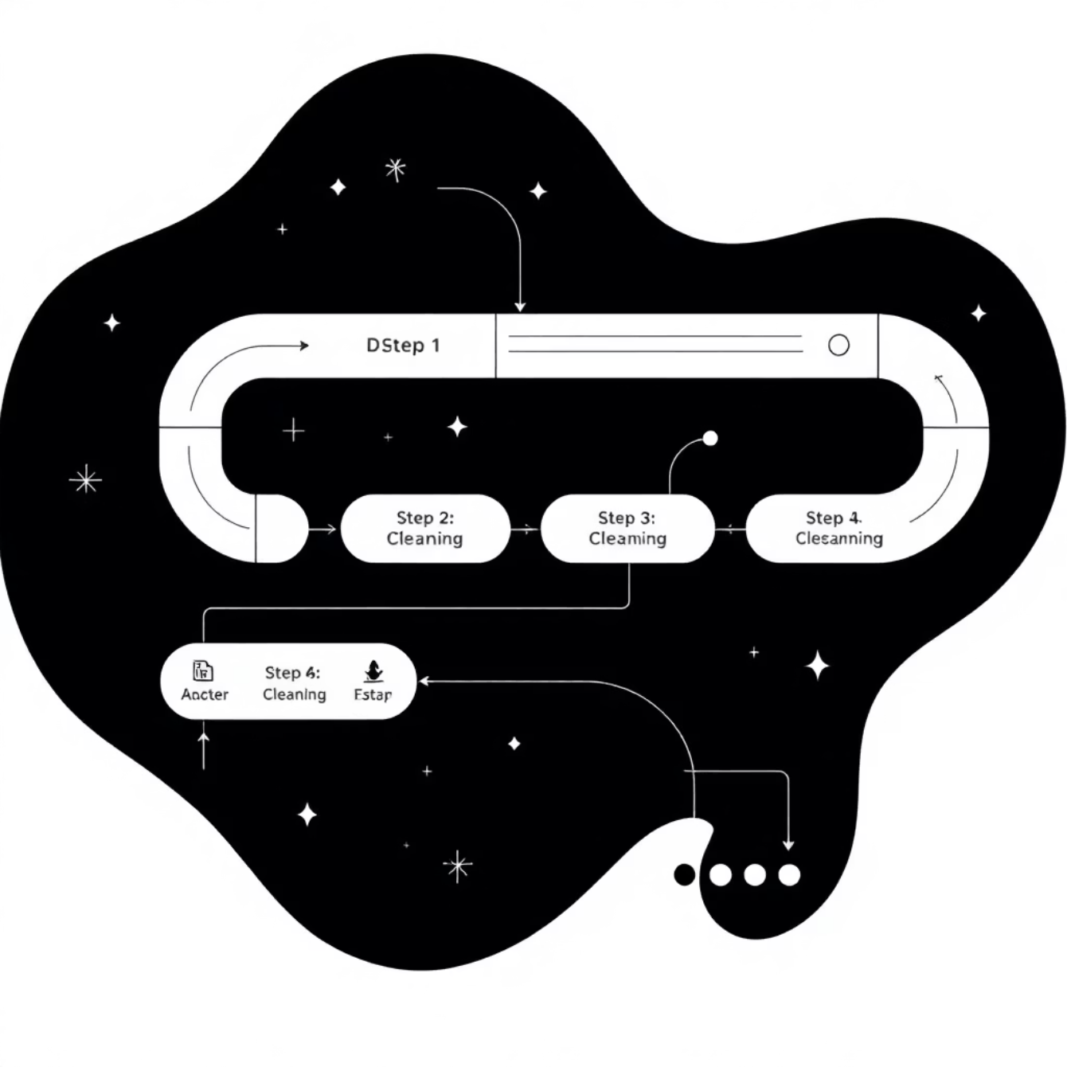
Data Cleaning & Preprocessing Excellence
Rigorous Data Preparation
01
Quality Control
Removed duplicates, blank rows, and irrelevant columns to ensure data integrity
Identified and defined the Primary Key (Booking_ID) for unique I identification
02
Date Integration
Merged Arrival_Year, Month, and Day columns into the (Arrival_Date) field
Combined Stay_in_weekend_Night and Stay_in_Week_Nights → Total_Number_Of_Days
03
Feature Engineering
Created Total_Number_of_Days and Total_Guests calculated columns
04
Missing Value Treatment
Handled null values in Country, Agent, and ADR fields strategically

Slide 6
Advanced Data Engineering & DAX Measures
1
2
3
Stay Categorisation
Revenue Calculation
Guest Loyalty Metrics
Created Stay_Category field classifying bookings as Short, Medium, or Long stays for trend analysis
Derived Revenue_per_Stay = ADR × Total stay days to quantify booking value
Calculated Repeated Guest percentage to measure customer retention
DAX Measures Developed
Total Bookings – Complete booking volume tracking
Cancellation Rate – Booking abandonment analysis
Total Revenue – Comprehensive revenue aggregation
Repeated Guest % – Loyalty measurement
Average ADR – Daily rate benchmarking
Revenue per Guest – Customer value metrics

Slide 7
Key Visualisations Driving Insights
Bookings by Hotel Type
Cancellation Analysis
Monthly Trends
Geographic Distribution
Comparative analysis of resort vs. city hotel demand patterns
Market segment breakdown revealing cancellation drivers
Seasonal booking patterns and revenue fluctuations
Top countries by booking volume with interactive mapping
Stay Category Mix
ADR Performance
Distribution across short, medium, and long-stay bookings
Daily rate comparison across property types and segments

Slide 8
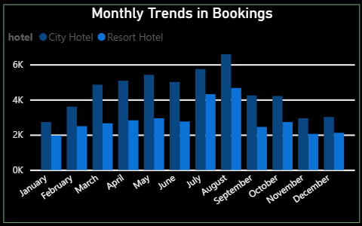
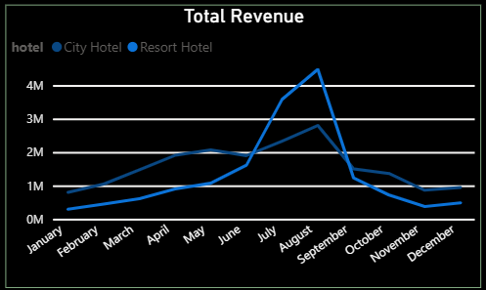
Monthly Trends In Bookings
Purpose: To analyze how hotel bookings fluctuate across different months and identify peak and off-peak seasons. Insights: The chart reveals a clear seasonal pattern — bookings are higher during vacation months, while off-season months show a noticeable drop.
Resort hotels generally show higher booking volumes during summer, while city hotels maintain more consistent performance throughout the year. Why It’s Important: By comparing bookings month-over-month, management can plan targeted marketing campaigns and promotions during low-demand months — improving year-round occupancy and profitability.
Total Revenue
Purpose: To understand the total revenue generated by the hotel across different time periods and identify key revenue-driving factors. Insights: The chart reveals a clear seasonal pattern — bookings are higher during vacation months, while off-season months show a noticeable drop.
Resort hotels generally show higher booking volumes during summer, while city hotels maintain more consistent performance throughout the year. Why It’s Important: Linking revenue data with stay duration and market segments enables the hotel to identify high-value customer groups — guiding targeted promotions and premium service offerings to boost future profits..

Slide 9
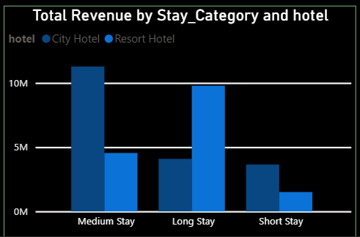
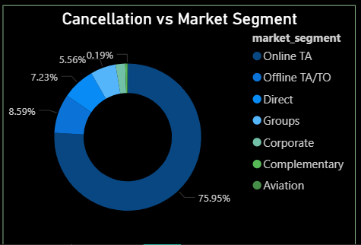
Total Revenue By Stay Category
Purpose: To analyze how different types of stays — Short Stay, Medium Stay, and Long Stay — contribute to the hotel’s total revenue. Insights: Medium and Long stays generate the highest share of total revenue, even if their booking count is lower, due to longer durations and higher spending per guest.
Short stays bring quick turnovers but lower revenue contribution, mainly from business travelers or short city visits. Why It’s Important: Focusing on upselling short-stay guests into medium stays (through extended-stay offers or discounts) can directly increase average revenue per booking without additional marketing costs.
Cancellation VS Market Segment
Purpose: To identify which market segments (Online TA, Offline TA/TO, Corporate, Direct, etc.) have the highest booking cancellation rates.. Insights: Online Travel Agencies (OTA) show the highest cancellation percentage, often due to flexible booking policies and competitive pricing platforms.
Direct bookings and corporate clients have much lower cancellation rates, indicating more reliable and confirmed stays. Why It’s Important: By promoting direct booking incentives (like loyalty rewards or discounts), the hotel can reduce dependency on high-cancellation segments, leading to more predictable revenue and improved operational efficiency.

Slide 10
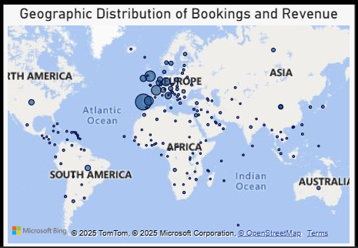
Geographic Distribution Of Bookings And Revenue
Purpose:
To visualize the origin of guests and analyze how different countries contribute to overall bookings and hotel revenue.
Insights:
The map shows that certain countries contribute significantly higher booking volumes, indicating key customer markets.
Guests from specific regions (e.g., domestic or nearby countries) often drive consistent bookings, while international guests bring higher average revenue per stay.
Why It’s Important:
This insight helps management identify target markets for promotions, allocate marketing budgets more effectively, and design region-specific offers.By integrating this insight with seasonal data, the hotel can forecast demand by geography — enabling location-based pricing strategies and strategic expansion planning in high-performing regions.

Slide 11
KPI Metrics: Management Decision Framework
87K
109.6
37%
3.2
Total Bookings
Average ADR
Cancellation Rate
Avg Stay Duration
Complete volume tracking for capacity planning
Daily rate benchmarking for pricing strategy
Risk assessment for revenue forecasting
Guest behaviour patterns for service optimisation
34.86M
15%
Total Revenue
Repeat Guests
Overall financial performance measurement
Customer loyalty and retention indicator
Each KPI provides actionable intelligence—from pricing optimisation to loyalty programme development—enabling strategic decision-making across operations, marketing, and revenue management functions.

Slide 12
Strategic Insights & Key Observations
Resort Premium vs. Cancellation Risk
City Hotel Loyalty Advantage
Online TA Paradox
Online travel agents drive substantial booking volume but contribute disproportionately to cancellations
Resort hotels command higher ADR but experience elevated cancellation rates, suggesting opportunities for flexible booking policies
City properties attract significantly more repeat guests, indicating stronger brand loyalty in urban markets
Seasonal Revenue Patterns
Direct Booking Value
Revenue peaks during summer months, with July and August showing 45% higher booking values than winter periods
Direct reservations demonstrate lowest cancellation rates and highest customer lifetime value

Slide 13





Data-Driven Recommendations & Future Vision
Immediate Action Plan
OTA Partnership Enhancement
Negotiate revised refund policies with online travel agents to reduce cancellation impact
Loyalty Programme Launch
Implement targeted retention strategies for high-value repeat guests
Peak Season Optimisation
Deploy premium pricing and exclusive packages during high-demand months
City Hotel Weekend Focus
Promote city properties for leisure weekend breaks to maximise occupancy
Future Scope
Expand analysis to include customer satisfaction scores and social media feedback.
Integrate real-time data sources (e.g., live booking systems) for dynamic dashboard updates.

Slide 14

Conclusion
The analysis provided a clear understanding of booking patterns, customer behavior, and revenue drivers.
Power BI helped transform raw booking data into actionable insights for strategic decisions.
Key findings revealed that medium and long stays, direct bookings, and specific market segments generate the most consistent revenue.
Cancellation trends highlighted opportunities to optimize policies and promote direct booking channels.
Overall, this project demonstrates how data analytics can enhance operational efficiency, improve forecasting, and support data-driven hotel management.

Slide 15
Thank You : )

